Slide 1
F
FROSTMART UK
Inventory Optimization:
From Gut-Feel to Data-Driven
Turning £15.66M of Identified Waste Into a Short List of Fixable Targets

Slide 2
Business Objective
Why this project exists
FrostMart leadership is moving away from gut-feeling inventory planning. This analysis brings historical sales, weather, and supply chain data together into a single interactive Power BI dashboard — giving Store Managers and the Procurement Team a shared, evidence-based view of exactly what's driving product waste and missed sales.
The goal isn't just a report, it's a decision-making tool that turns “we think it's the bakery” into “here are the 7 products, 1 region, and 3 suppliers actually responsible for it.”
£12.2M
£
Reported annual loss FrostMart is aiming to reduce, from waste and missed sales (per brief)
5
5
Linked datasets: weekly sales, product, store, weather & supplier data
3
3
Dashboard views built: Executive, Environmental Impact, Supply Chain Operations
£
£15.66M
Total wastage cost identified directly in the data — the visible, fixable core of the loss
FrostMart UK | Inventory Optimization Capstone
2

Slide 3
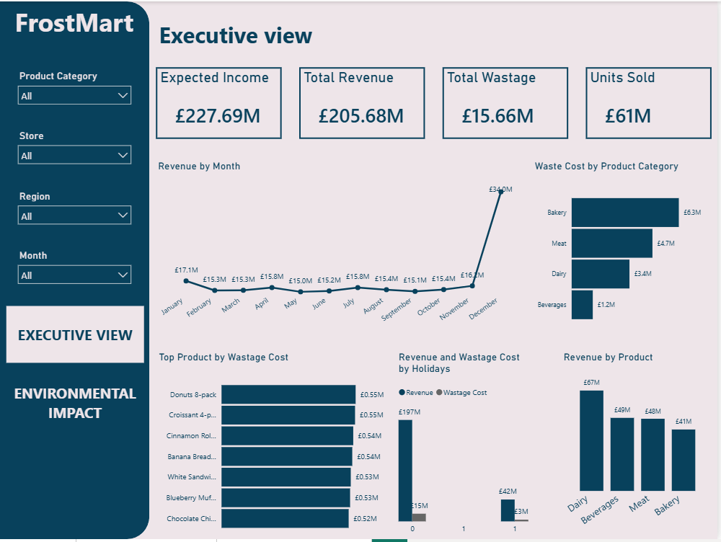
Dashboard — Executive View
Overall financial health: which categories drive revenue vs. waste.
£205.68M Revenue • £15.66M Wastage • 61M Units Sold
Revenue by Month — Flat around £15–16M most months, then December jumps to £34.0M — about 2.2× a typical month.
Waste Cost by Category — Bakery is highest (£6.3M), then Meat (£4.7M), Dairy (£3.4M), Beverages lowest (£1.2M).
Revenue by Product — Dairy earns the most (£67M); Bakery earns the least (£41M) — the very same category with the highest waste.
Top Products by Wastage Cost — The 7 worst individual products — all Bakery — each waste ≈£0.52–£0.55M, totalling nearly a quarter of all wastage company-wide.
Revenue & Waste by Holiday — Revenue is generated a lot on normal weeks along with a 15m wastage cost of products but on holiday weeks revenue is significantly low and waste is least. Because normal weeks bring steady sales, staff might over-order routines without checking actual demand patterns, leading to heavy waste.
Reading this page: Bakery is the paradox category — lowest revenue, highest waste — while December is a demand spike the rest of the year isn't built around.
FrostMart UK | Inventory Optimization Capstone
3

Slide 4
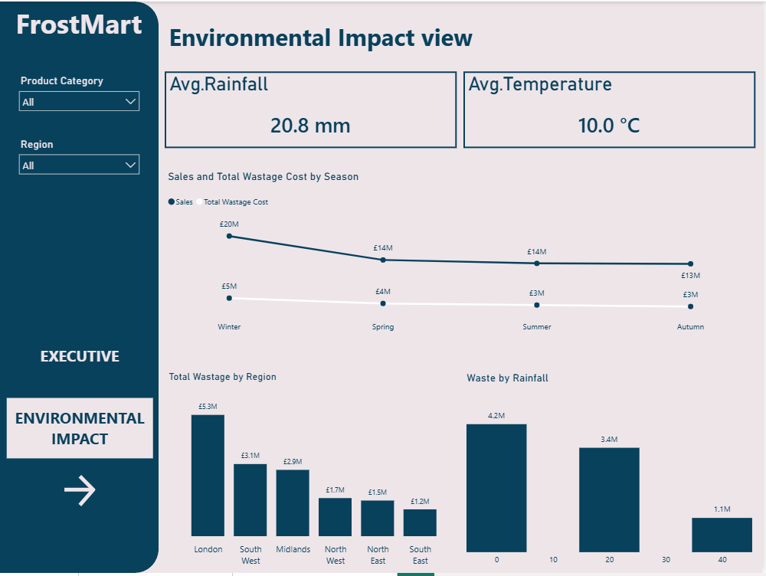
Dashboard — Environmental Impact
How season, region and weather relate to sales and waste.
20.8mm Avg Rainfall • 10.0°C Avg Temperature
Sales & Waste by Season — Winter (which includes December) leads both units sold and wastage cost; Autumn is the leanest season for both — consistent with the holiday surge on the Executive page.
Total Wastage by Region — London is a clear outlier at £5.3M — about 70% more than the next-highest region (South West, £3.1M) and 4.4× the lowest (South East, £1.2M).
Waste by Rainfall — Wastage appears concentrated in lower-rainfall weeks in the sample shown — an interesting pattern, but one that needs more data before treating it as a confirmed driver.
Reading this page: waste isn't spread evenly across the UK — it clusters hard in one region and one season, both pointing back to the same holiday-driven story.
FrostMart UK | Inventory Optimization Capstone
4

Slide 5
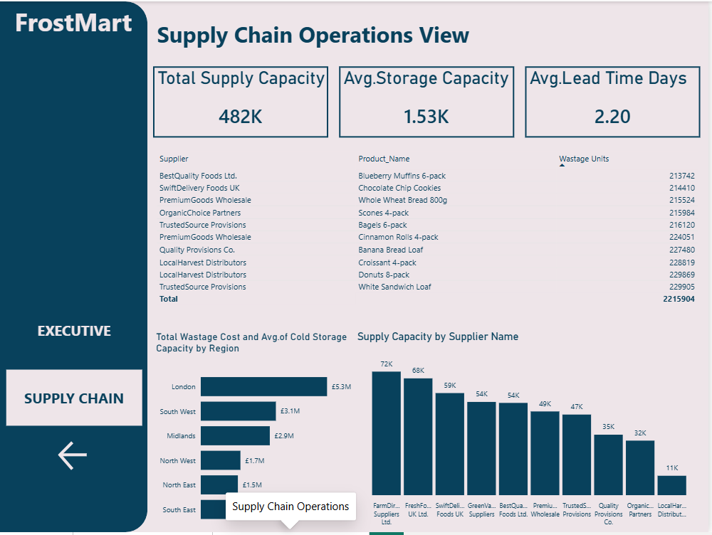
Dashboard — Supply Chain Operations
Which suppliers are tied to the highest-spoilage products.
482K Weekly Supply Capacity • 2.20 days Avg Lead Time
Top Wastage Products Table — The 10 worst products across the business total 2,215,904 wasted units combined.
Supplier Concentration — 3 suppliers — LocalHarvest Distributors, TrustedSource Provisions & PremiumGoods Wholesale — each appear twice in that list, make 61% of those 2.2M wasted units.
Supply Capacity by Supplier — LocalHarvest Distributors has by far the smallest weekly capacity (11K) of any of the 10 suppliers — under a third of the next-smallest (OrganicChoice Partners, 32K) — yet it's tied to 2 of the highest-spoilage products.
Regional Wastage (repeated) — Confirms London as the top-waste region from a supply lens too, echoing the Environmental Impact page.
Reading this page: the spoilage problem isn't spread evenly across the supply base — it's concentrated in 3 suppliers, and one of them is also the most capacity-constrained.
FrostMart UK | Inventory Optimization Capstone
5

Slide 6
Key Insights
What the data shows about where FrostMart's £15.66M in waste actually comes from.
1
Bakery is a paradox category
It has the lowest revenue of any category (£41M) and the highest waste (£6.3M) — a 15.4% waste rate, more than 6× Beverages (2.4%).
2
7 products drive a quarter of all waste
The worst 7 individual products — all Bakery — total ≈£3.76M in wastage, roughly 24% of FrostMart's entire £15.66M wastage bill, from a tiny slice of the catalogue.
3
Dairy is the profit engine to protect
It has the highest revenue of any category (£67M) with a comparatively low ≈5.1% waste rate — the category the rest should learn from.
4
December alone reshapes the year
Revenue jumps to £34.0M — about 2.2× a typical month (≈£15.6M) — a holiday surge current ordering may not be fully built around.
5
Waste is concentrated, not spread out
London wastes 4.4× the lowest region, and just 3 suppliers account for 61% of the worst-spoilage products — a handful of targeted fixes could move most of the needle.
FrostMart UK | Inventory Optimization Capstone
6

Slide 7
Recommendations & Solutions
Top 3 priority actions, plus two supporting moves to close the brief's open questions.
PRIORITY
Automatically lower the prices on bakery items that are about to expire so people buy them before they spoil.
Automatically give bigger discounts to items near their expiration date when customers pay at the checkout. Testing this on just the 7 items with the highest waste can save £3.76 million (which is nearly a quarter of all food waste costs).
1
2
Adjust how much we buy from the 3 suppliers whose products spoil the most, so we order less from them and stop wasting food.
Review order size and frequency with LocalHarvest Distributors, TrustedSource Provisions & PremiumGoods Wholesale specifically; cap LocalHarvest's orders at its real 11K/week capacity instead of over-ordering against a supplier that structurally can't flex.
Check how much and how often we order from three specific suppliers, and limit orders for LocalHarvest to 11,000 units per week so we don't buy more than they can actually deliver.
London wastes 4.4 times more food than the best region, so checking London's fridges, delivery schedules, and sales predictions will fix our biggest regional problem.
3
FrostMart UK | Inventory Optimization Capstone
7

Slide 8
Conclusion
FrostMart's waste problem isn't random — it's concentrated in one category (Bakery), one month (December), one region (London), and three suppliers. That concentration is good news: it means a handful of targeted, evidence-backed actions — not a company-wide overhaul — can meaningfully close the gap toward the £12.2M loss FrostMart set out to fix.
The dashboard is built to keep tracking these exact signals — Bakery waste rate, the December surge, London's regional gap, and the 3 concentrated suppliers — so Store Managers and Procurement can see, every week, whether the fixes are actually working.
Thank you
FrostMart UK | Inventory Optimization Capstone
8

